Slide 1
Branch Hazards in the Pipelined Processor

Slide 2
Dependences
Data dependence: one instruction is dependent on another instruction to provide its operands.
Control dependence (aka branch dependences): one instructions determines whether another gets executed or not.
Control dependences are particularly critical with conditional branches.
add $5, $3, $2
sub $6, $5, $2
beq $6, $7, somewhere
and $9, $3, $1
data dependences
control dependence

Slide 3
Branch Hazards
Branch dependences can result in branch hazards (aka control hazards) when they are too close to be handled correctly in the pipeline.

Slide 4
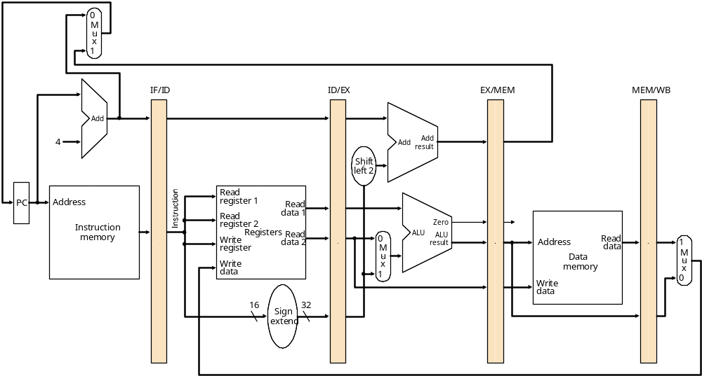
When are branches resolved?
Instruction Fetch
Instruction Decode
Execute/
Address Calculation
Memory Access
Write Back
Branch target address is put in PC during Mem stage.
Correct instruction is fetched during branch’s WB stage.

Slide 5
Branch Hazards
CC1
CC2
CC3
CC4
CC5
CC6
CC7
CC8
beq $2, $1, here
IM
Reg
ALU
DM
Reg
add ...
IM
Reg
ALU
DM
Reg
IM
Reg
ALU
DM
Reg
sub ...
These instructions
shouldn’t be executed!
IM
Reg
ALU
DM
Reg
lw ...
IM
Reg
ALU
DM
here: lw ...
Finally, the right instruction

Slide 6
Dealing With Branch Hazards
Software solution
  insert no-ops (I don’t think any processors do this)
Hardware solutions
  stall until you know which direction branch goes
  guess which direction, start executing chosen path (but be prepared to undo any mistakes!)
    static branch prediction: base guess on instruction type
    dynamic branch prediction: base guess on execution history
  reduce the branch delay
Software/hardware solution
  delayed branch: Always execute instruction after branch.
    Compiler puts something useful (or a no-op) there.

Slide 7
Stalling for Branch Hazards
CC1
CC2
CC3
CC4
CC5
CC6
CC7
CC8
beq $4, $0, there
IM
Reg
DM
Reg
and $12, $2, $5
Bubble
Bubble
Bubble
IM
Reg
DM
Reg
or ...
IM
Reg
DM
Reg
IM
Reg
DM
add ...
IM
Reg
sw ...

Slide 8
Stalling for Branch Hazards
All branches waste 3 cycles.
  Seems wasteful, particularly when the branch isn’t taken.
It’s better to guess whether branch will be taken
  Easiest guess is “branch isn’t taken”

Slide 9
Assume Branch Not Taken
works pretty well when you’re right – no wasted cycles
CC1
CC2
CC3
CC4
CC5
CC6
CC7
CC8
beq $4, $0, there
IM
Reg
DM
Reg
and $12, $2, $5
IM
Reg
DM
Reg
or ...
IM
Reg
DM
Reg
IM
Reg
DM
add ...
IM
Reg
sw ...

Slide 10
Assume Branch Not Taken
same performance as stalling when you’re wrong
CC1
CC2
CC3
CC4
CC5
CC6
CC7
CC8
beq $4, $0, there
IM
Reg
DM
Reg
Whew! none of these
instruction have changed
memory or registers.
and $12, $2, $5
IM
Reg
Flush
or ...
IM
Reg
Flush
IM
Flush
add ...
IM
Reg
there: sub $12, $4, $2

Slide 11
Some other static strategies
Assume backwards branch is always taken, forward branch never is
  “backwards” = negative displacement field
  loops (which branch backwards) are usually executed multiple times.
  “if-then-else” often takes the “then” (no branch) clause.
Compiler makes educated guess
  sets “predict taken/not taken” bit in instruction

Slide 12
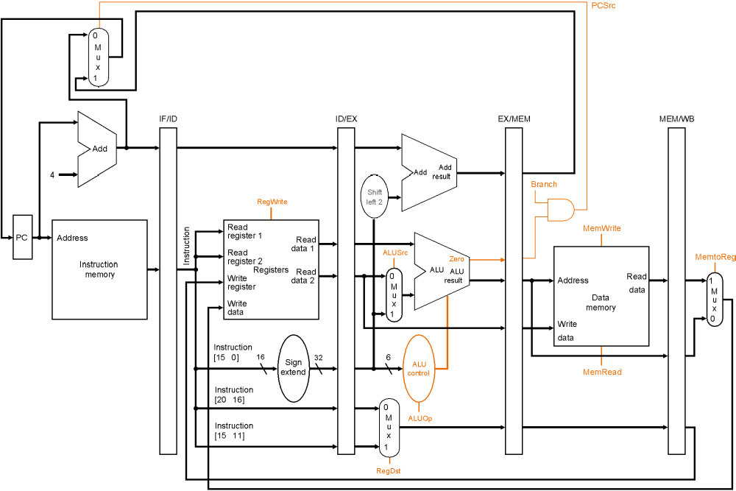
Reducing the Branch Delay
it’s easy to reduce stall to 2-cycles

Slide 13
Reducing the Branch Delay
it’s easy to reduce stall to 2-cycles

Slide 14
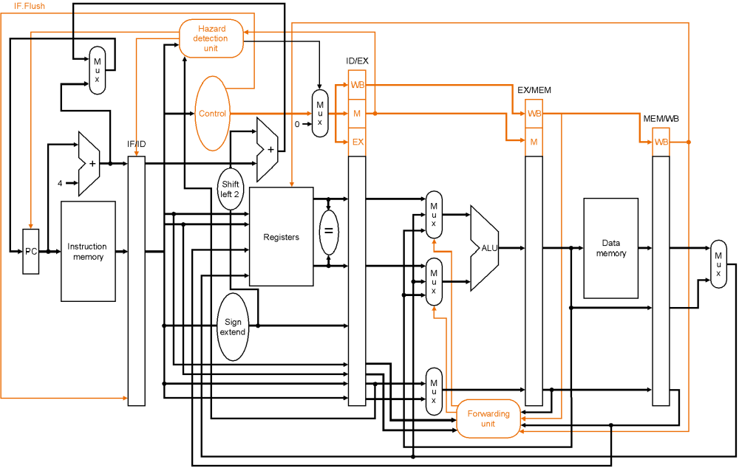
One-cycle branch misprediction penalty
Target computation & equality check in ID phase.
  This figure also shows flushing hardware.

Slide 15
Stalling for Branch Hazards with branching in ID stage
CC1
CC2
CC3
CC4
CC5
CC6
CC7
CC8
beq $4, $0, there
IM
Reg
DM
Reg
and $12, $2, $5
Bubble
IM
Reg
DM
Reg
or ...
IM
Reg
DM
Reg
IM
Reg
DM
add ...
IM
Reg
sw ...

Slide 16
Eliminating the Branch Stall
There’s no rule that says we have to branch immediately. We could wait an extra instruction before branching.
The original SPARC and MIPS processors used a branch delay slot to eliminate single-cycle stalls after branches.
The instruction after a conditional branch is always executed in those machines, whether the branch is taken or not!

Slide 17
Branch Delay Slot
CC1
CC2
CC3
CC4
CC5
CC6
CC7
CC8
beq $4, $0, there
IM
Reg
DM
Reg
and $12, $2, $5
IM
Reg
DM
Reg
there: xor ...
IM
Reg
DM
Reg
IM
Reg
DM
add ...
IM
Reg
sw ...
Branch delay slot instruction (next instruction after a branch) is
executed even if the branch is taken.

Slide 18
Filling the branch delay slot
The branch delay slot is only useful if you can find something to put there.
  Need earlier instruction that doesn’t affect the branch
If you can’t find anything, you must put a nop to insure correctness.
Worked well for early RISC machines.
  Doesn’t help recent processors much
  E.g. MIPS R10000, has a 5-cycle branch penalty, and executes 4 instructions per cycle.
Meanwhile, delayed branch is a permanent part of the ISA.

Slide 19
Branch Prediction
Static branch prediction isn’t good enough when mispredicted branches waste 10 or 20 instructions .
Dynamic branch prediction keeps a brief history of what happened at each branch.

Slide 20
Branch Prediction
Branch history table
program counter
1
0000
0001
0010
0010
0011
0100
0101
...
1
for (i=0;i<10;i++) {
...
...
}
0
1
1
0
...
...
add $i, $i, #1
beq $i, #10, loop
This ‘1’ bit means, “the
last time the program
counter ended with 0100
and a beq instruction
was seen, the branch
was taken.” Hardware guesses it will be taken again.

Slide 21
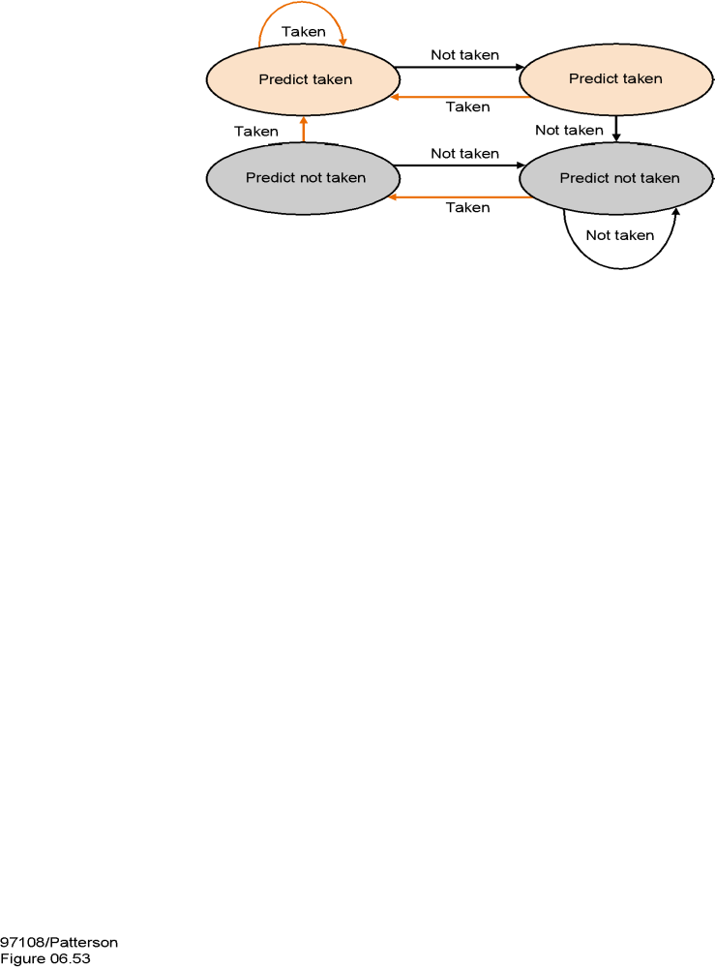
Two-bit predictors are even better
(Branch prediction is a hot research topic)
this state means, “the last
two branches at this
location were taken.”
This one means, “the
last two branches at this
location were not taken.”

Slide 22
Branch Hazards -- Key Points
Branch (or control) hazards arise because we must fetch the next instruction before we know if we are branching or not.
Branch hazards are detected in hardware.
We can reduce the impact of branch hazards through:
  computing branch target and testing early
  branch delay slots
  branch prediction – static or dynamic

Slide 23
Computer of the Day
1963: Seymour Cray’s CDC 6600
  First supercomputer. 10 MHz clock. (Individual transistors!)
  Also first Register-Register (i.e. Load-Store) ISA machine.
  10 multicycle functional units in the “Central” processor
    float + (4 cycle), 2 float x ’s (10 cyc), float divide (29 cyc), assorted boolean & integer units (most 3 cyc), branch (9 cyc)
    Unrelated instructions can be executed concurrently.
  10 “Peripheral & Control” processors for I/O
  60-bit words, 15-bit 3-address instructions (also has 30-bit inst’s)
  60-bit general registers, plus 18-bit address & index regs
  8 word instruction cache (no data cache)
    28 or fewer instructions in loop for peak speed
    Programmer’s goal – provably optimal code
Notes:
Guess what the instruction format was ... 2 bit register specifiers? No, too few registers. 4 bit ones? That would only leave 3 bits for OPcode – not enough. So it’s a 6 bit opcode and 3 3-bit registers. Interesting (to me) aside – Load of X1-X5 register is side-effect of putting something in A1-A5 register; store of X6 or X7 is side-effect of having A6 or A7 target.

Slide 24
Quiz #2
You did well ...
  Top quartile: 34 (out of 40)
  Median: 31.5
  Third quartile: 27
I still grade on a curve ... but average is about “B”
Nobody got #6 right!
  Yes, you can eliminate a MUX on the register write port
  Yes, you need a MUX on the second register read port
  But how do you set this MUX on the 2nd cycle?
    If you choose “rt”, then you can’t execute R-type in 4 cycles.
    If you choose “rd”, then you can’t execute beq in 3 cycles.
    If you make it depend on instruction, you slow down control !!

